Slide 1
Advanced Topics in Programming Lab 5 – Java Containers and Design Patterns
We will start at 9:10
Lab schedule:
Java Containers
Design Patterns
Factory + Lab exercise 1
Command + Lab exercise 2
Lab exercise 3

Slide 2
Advanced Topics in Programming
Lab 5 – Java Containers and Design Patterns

Slide 3
Java Containers

Slide 4
Java Containers
Java has 2 types of containers:
Collections – collect single values
Lists / Queues – sequence is important
Sets – each element appears only once
Maps – map keys to values
The implementation is as you have learned in Data-Structures course
Use them wisely

Slide 5
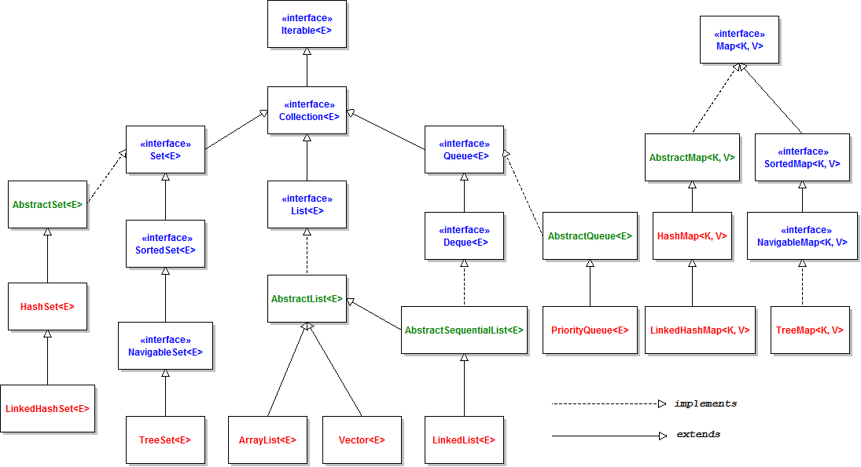
Java Containers

Slide 6

Java Collections - Lists
ArrayList<E> - uses an array
Fast random access: O(1)
Slow addition / deletion from the middle: O(1) amortized
LinkedList<E> - uses a linked list
Slow random access: O(n)
Fast addition / deletion from the middle: O(1)
Example:

Slide 7
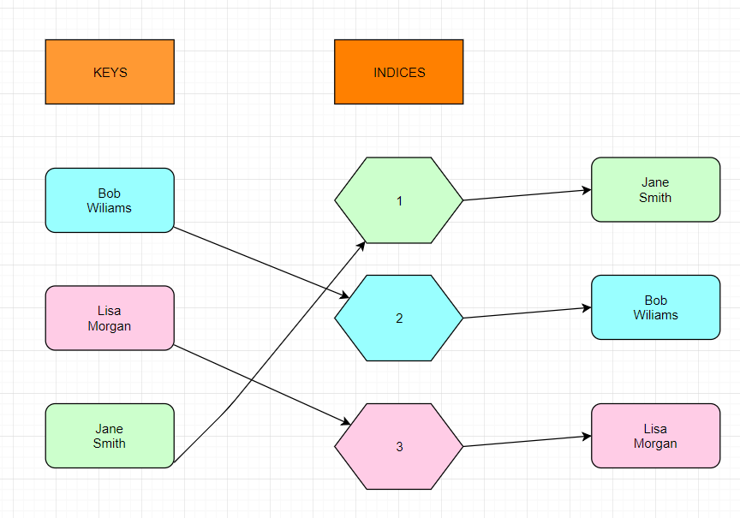
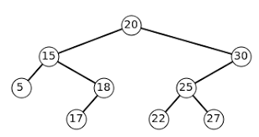

Java Collections - Sets
HashSet<E> - uses a hash table
Use when search time is important
Object’s int hashCode() method needs to be overridden
Usually we will use something ready as String’s hash code
TreeSet<E> - uses a balanced tree
O(log(n)) for random access
Can easily extract a sorted list
Example:

Slide 8
Java Containers - Maps
HashMap<K, V> - uses a hash table
The key object needs to implement hashCode() method
LinkedHashMap<K, V>
Also stores the order of entry
TreeMap<K, V> - uses a red-black tree
Can easily extract a sorted list
Example:

Slide 9
Design Patterns
Factory, Command

Slide 10

Factory Design Pattern

Slide 11
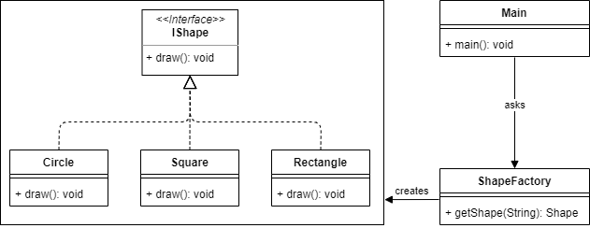
Factory Design Pattern

Slide 12

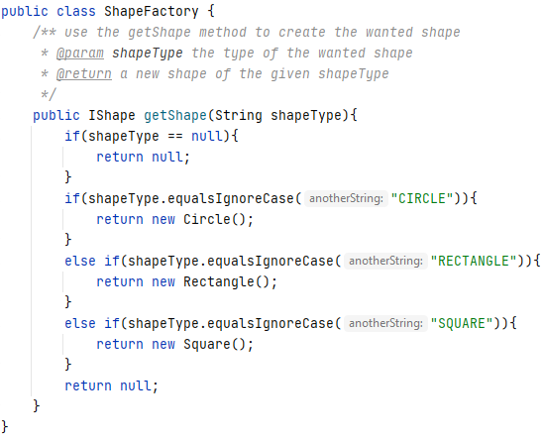
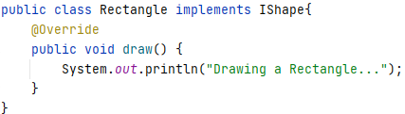
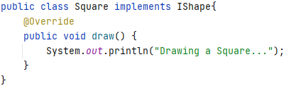
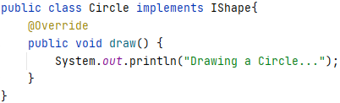
Factory Design Pattern – Code

Slide 13
SOLID checklist
S – Single Responsibility Principle
O – Open-Closed Principle
L – Liskov Substitution Principle
I – Interface Segregation Principle
D – Dependency Inversion Principle

Slide 14
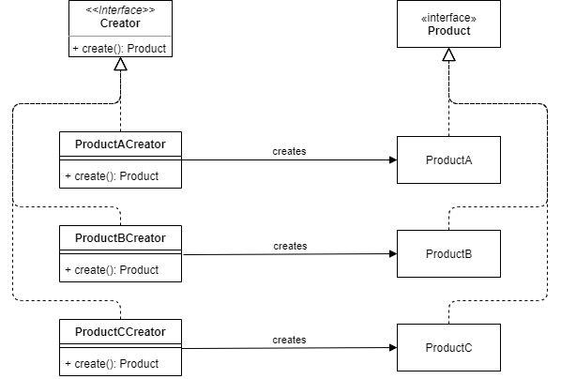
Factory Design Pattern – Improved

Slide 15
SOLID checklist
S – Single Responsibility Principle
O – Open-Closed Principle
L – Liskov Substitution Principle
I – Interface Segregation Principle
D – Dependency Inversion Principle

Slide 16
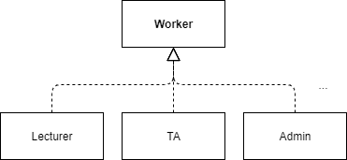
Lab exercise 1
Let’s say we have n types of workers
And when the user inputs the type, the right object needs to be instanced.
Creating n “if” statements takes O(n) time
It is also not very object oriented…
Utilize the factory pattern and containers to return the new worker in O(1).

Slide 17
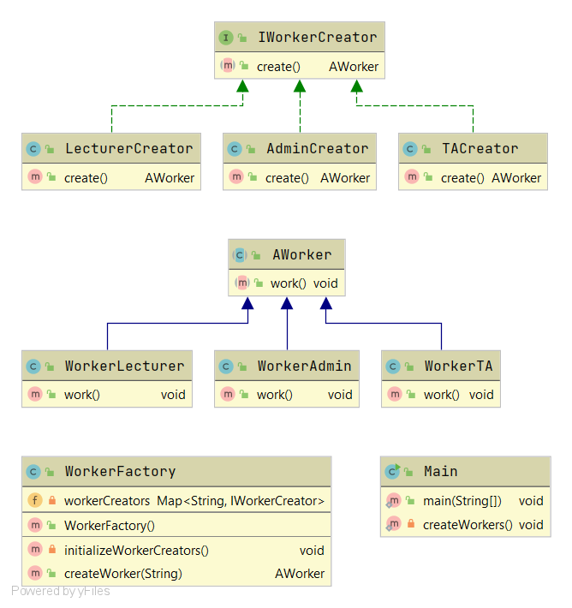
Lab exercise 1 – class diagram

Slide 18

Command Design Pattern

Slide 19
Command Design Pattern
A request is wrapped under an object as a command
Then it is passed to an invoker object
Invoker executes the command
Command executes the request

Slide 20
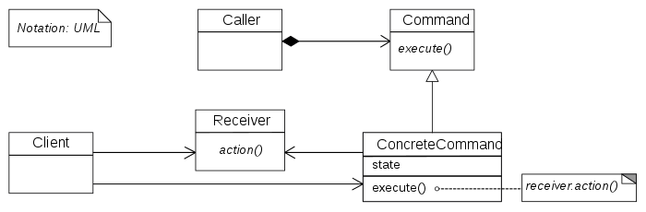
Command Design Pattern

Slide 21
Lab exercise 2
We have a lamp and we want to be able to turn it on and off however much time we want
Implement a system that enables the user to insert a series of commands, and then to run all of them one by one

Slide 22
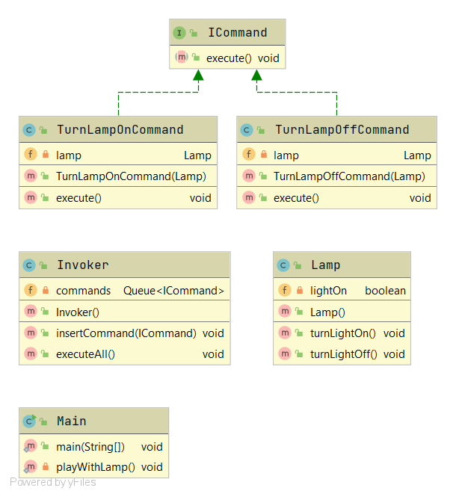
Lab exercise 2 – class diagram

Slide 23
Lab exercise 3
This lab exercise is in the given PDF file in moodle.
You also need to download the “IsoCountries.csv” file from moodle.
Part 1
Create Class FileReader
Part 2
Get to know Data Structures
Working with StopWatch

